Slide 1

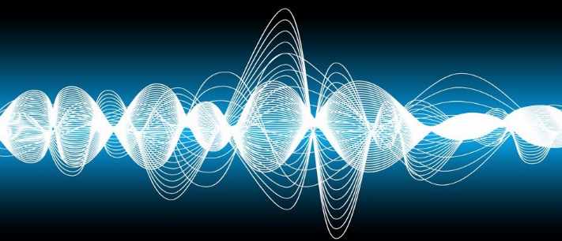
PHY 102
Waves

Slide 2
What is a wave?
……a self-sustaining disturbance of a medium travelling from one point to another carrying energy and momentum.
Examples are: musical sounds, string under tension, ripples on a pond, seismic tremors triggered by an earthquake
Waves can occur whenever a system is disturbed from equilibrium (rest) and when the disturbance can travel, or propagate, from one region of the system to another.
As a wave propagates, it carries energy.

Slide 3
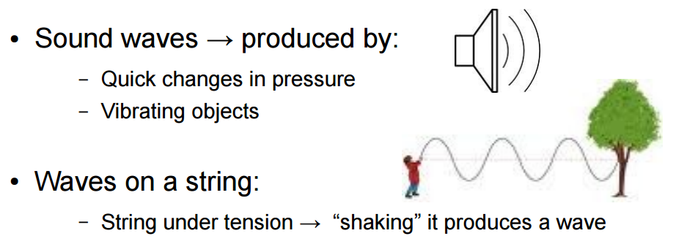

Slide 4
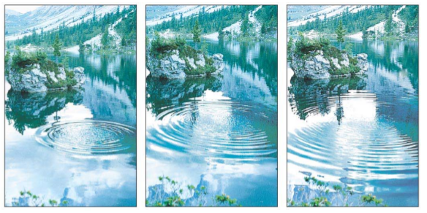
Water surface waves – produced by disturbing a flat water surface.

Slide 5
The energy in light waves from the sun warms the surface of our planet.
The energy in seismic waves can crack our planet’s crust.
These waves are Sinusoidal waves whose wave pattern is a repeating sine or cosine function.
There are two types of waves:
Mechanical waves : A disturbance that travels through some material or substance called the medium for the wave.

Slide 6
As the wave travels through the medium, the particles that make up the medium undergo displacements of various kinds, depending on the nature of the wave.
Examples are waves on a string, guitar, violin which all play an important role in music.
When a musician strums a guitar or bows a violin, waves that travel in opposite directions along the instrument’s strings are produced.

Slide 7
Sinusoidal waves occur on a guitar or violin string only for certain special frequencies called normal-mode frequencies, which is determined by the properties of the string.
The normal-mode frequencies of a stringed instrument determine the pitch of the musical sounds that the instrument produces.

Slide 8
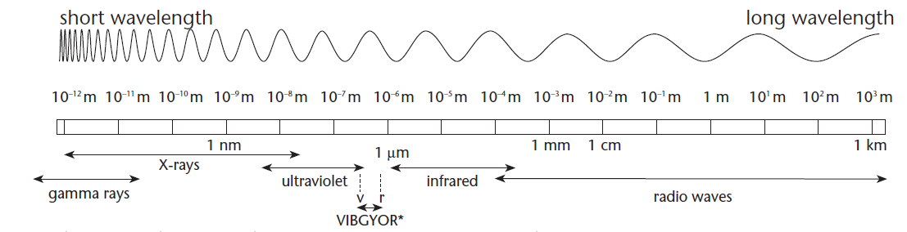
2. Electromagnetic waves are waves that propagate in empty space where there is no medium.
Examples are light, radio waves, infrared and ultraviolet radiation, and x rays.

Slide 9
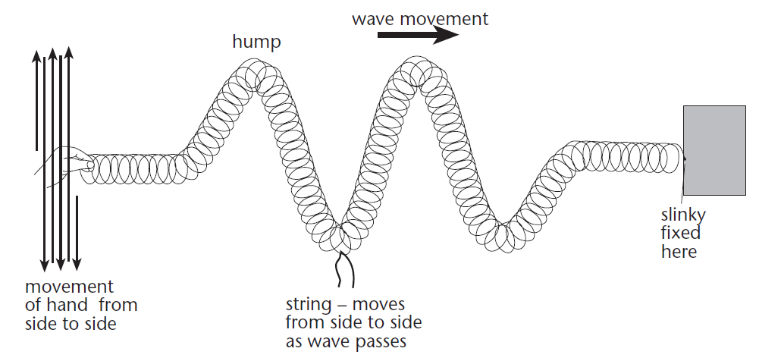
Types of mechanical waves are:
1. Transverse wave is a wave that is produced when the particles of a medium vibrate in a direction perpendicular to the direction of propagation of the wave itself.

Slide 10
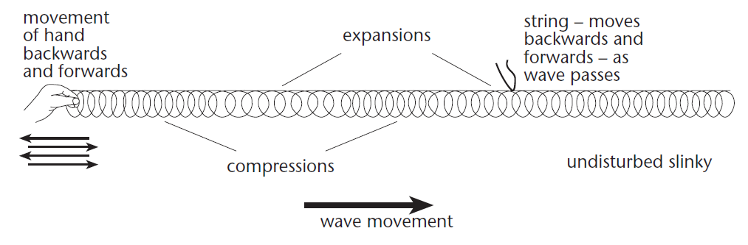
2. Longitudinal wave is a wave that is produced when the vibration of the particles of the medium is parallel to the direction of propagation of the wave.

Slide 11
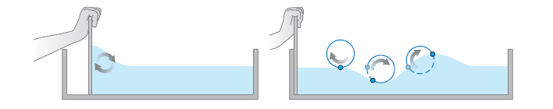
3. A combination of transverse and longitudinal waves is produced when a flat board at the left end moves forward and backward once down the length of a water channel as seen below.

Slide 12
Each of these systems has an equilibrium state.
For the stretched string it is the state in which the system is at rest, stretched out along a straight line.
For the fluid in a tube it is a state in which the fluid is at rest with uniform pressure.
For the liquid in a trough it is a smooth, level water surface.

Slide 13
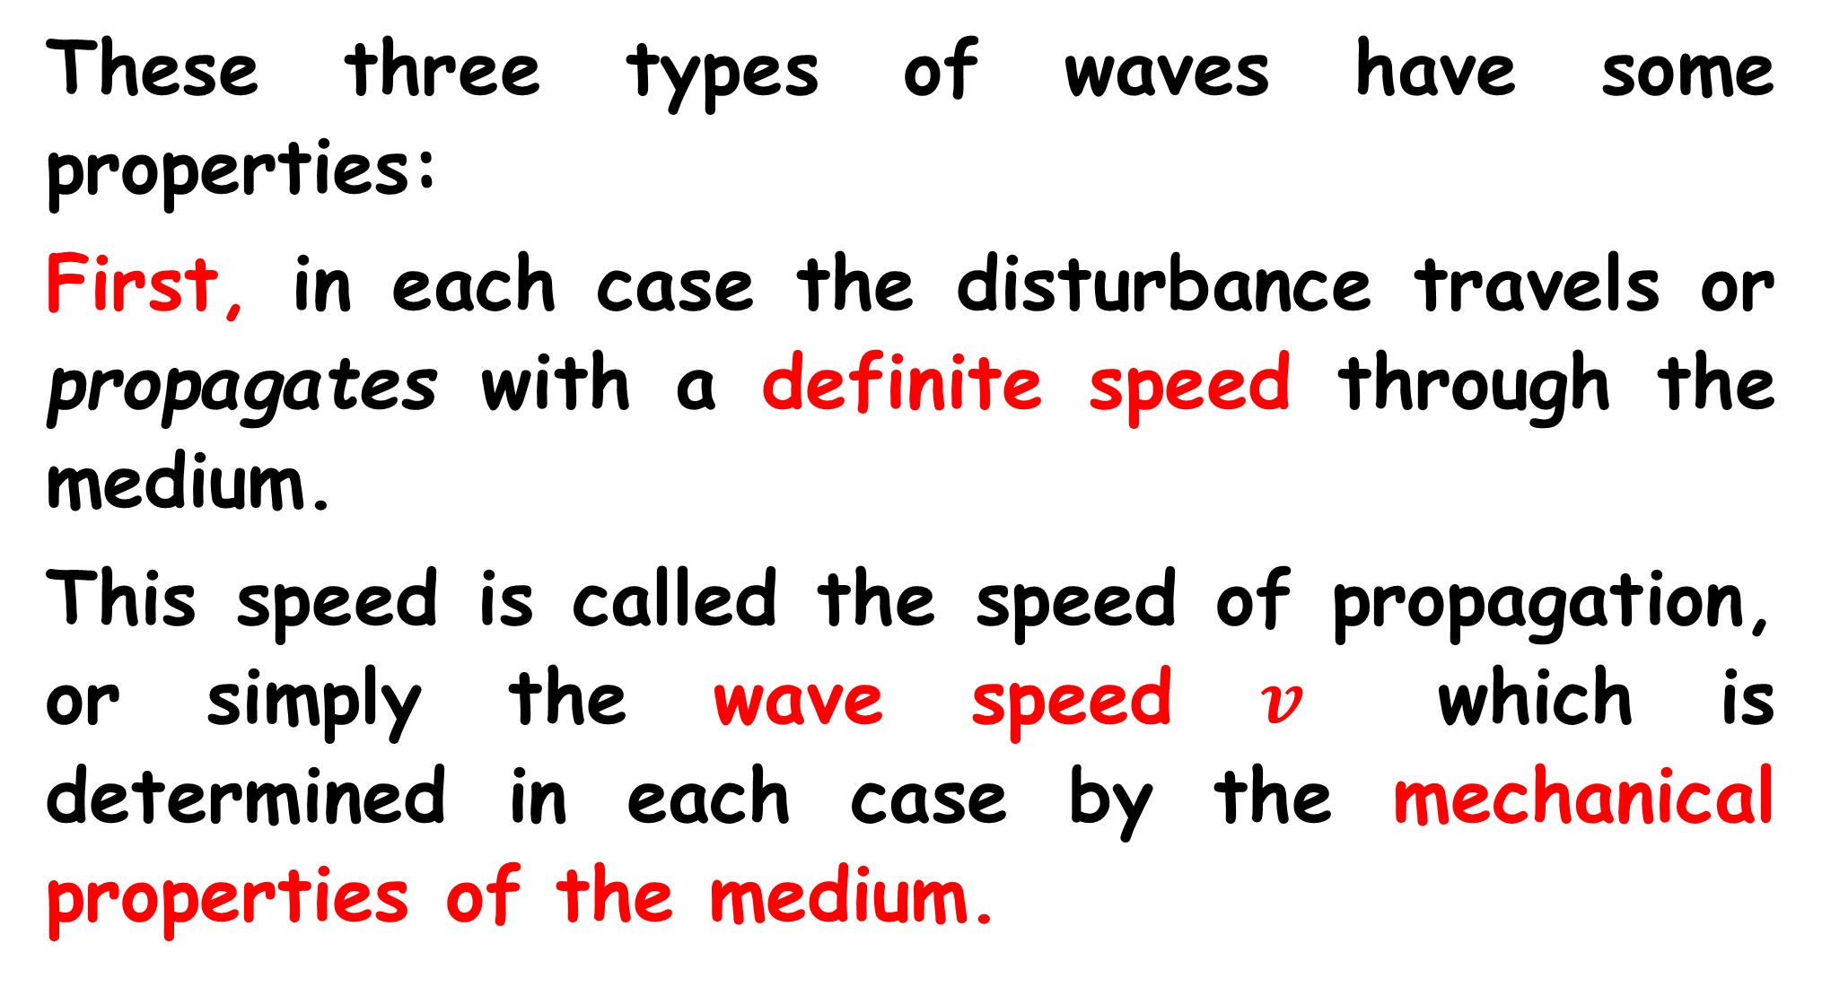
These three types of waves have some properties:
First, in each case the disturbance travels or propagates with a definite speed through the medium.
This speed is called the speed of propagation, or simply the wave speed $v$ which is determined in each case by the mechanical properties of the medium.

Slide 14
Second, the medium itself does not travel through space; its individual particles undergo back-and-forth or up-and-down motions around their equilibrium positions. The overall pattern of the wave disturbance is what travels.
Third, to set any of these systems into motion, we have to put in energy by doing mechanical work on the system.

Slide 15
The wave motion transports this energy from one region of the medium to another.
Waves transport energy, but not matter, from one region to another.
When the free end of the string is given a repetitive, or periodic, motion. Then each particle in the string also undergoes periodic motion as the wave propagates, hence a periodic wave is produced.

Slide 16
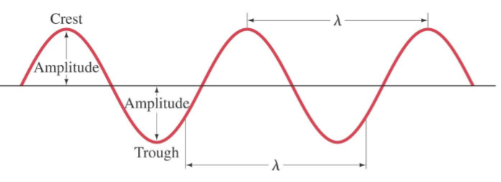
For a periodic transverse wave, the shape of the string at any instant is a repeating pattern.
The length of one complete wave pattern is the distance from one crest to the next or from one trough

Slide 17
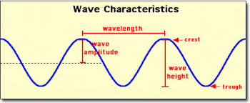
to the next, or from any point to the corresponding point on the next repetitive of the wave shape.

Slide 18
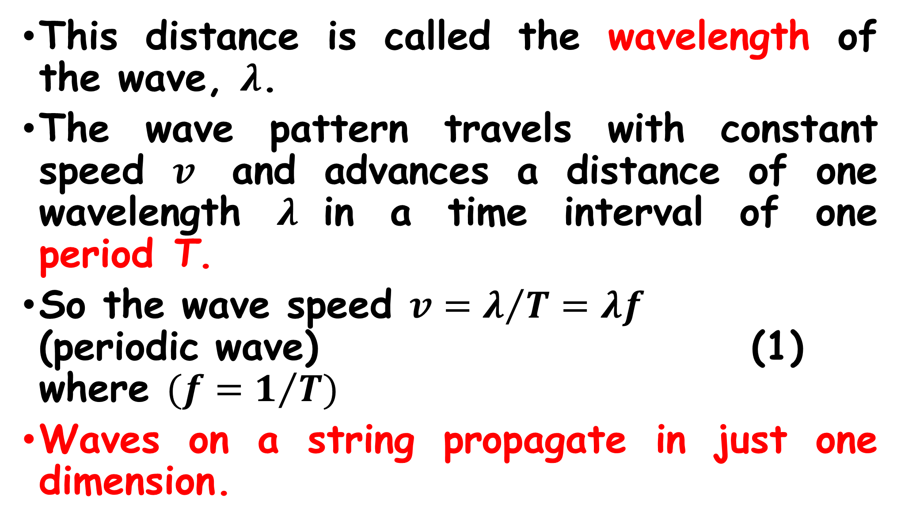
This distance is called the wavelength of the wave, $λ$.
The wave pattern travels with constant speed $v$ and advances a distance of one wavelength $λ$in a time interval of one period T.
So the wave speed $v=λ/T=λf$ (periodic wave) (1) where $(f=1/T)$
Waves on a string propagate in just one dimension.

Slide 19
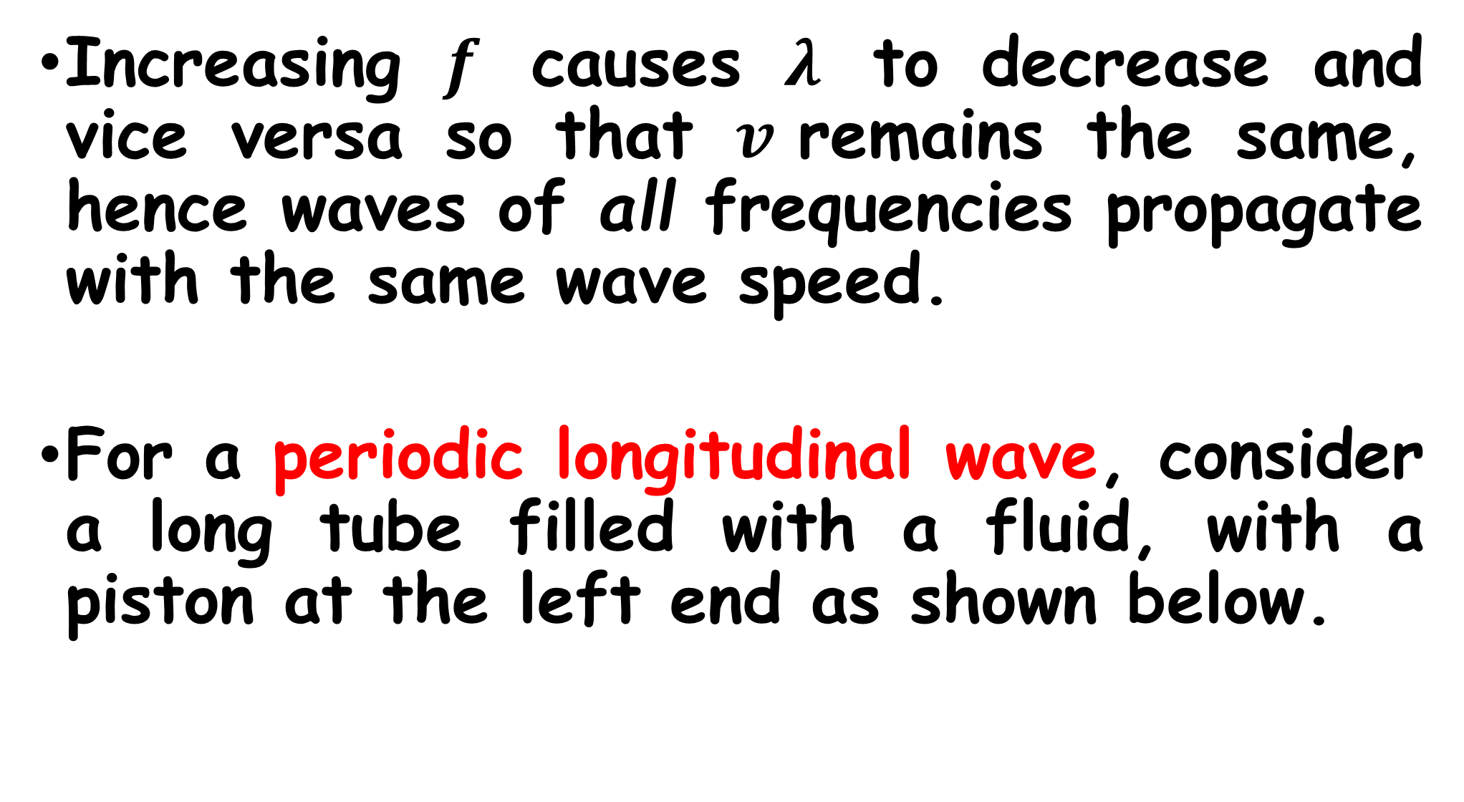
Increasing $f$ causes $λ$ to decrease and vice versa so that $v$remains the same, hence waves of all frequencies propagate with the same wave speed.
For a periodic longitudinal wave, consider a long tube filled with a fluid, with a piston at the left end as shown below.

Slide 20
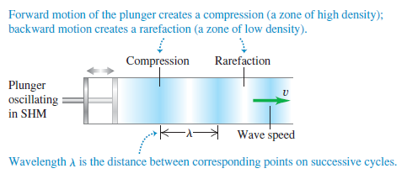

Slide 21
If the piston is pushed in, the fluid will be compressed near the piston, thus increasing the pressure in this region.
This region then pushes against the neighbouring region of fluid, and so on, and a wave pulse moves along the tube.
This back and forth motion forms regions in the fluid where the pressure and density are greater or less than the equilibrium values.

Slide 22
The region of increased density is a compression while the region of reduced density is a rarefaction.
The wavelength is also the distance from one compression to the next or from one rarefaction to the next.

Slide 23
Question
If the wavelength of a wave on a particular string is doubled, what happens to the wave speed and the frequency?
(i) doubles and is unchanged;
(ii) is unchanged and doubles;
(iii) becomes one-half as great and is unchanged;
(iv) is unchanged and becomes one-half as great;
(v) none of these.

Slide 24
Many characteristics of periodic waves can be described by using the concepts of wave speed, amplitude, period, frequency, and wavelength.
Waves on a string are transverse; during wave motion a particle with equilibrium position x is displaced some distance y in the direction perpendicular to the x-axis.

Slide 25
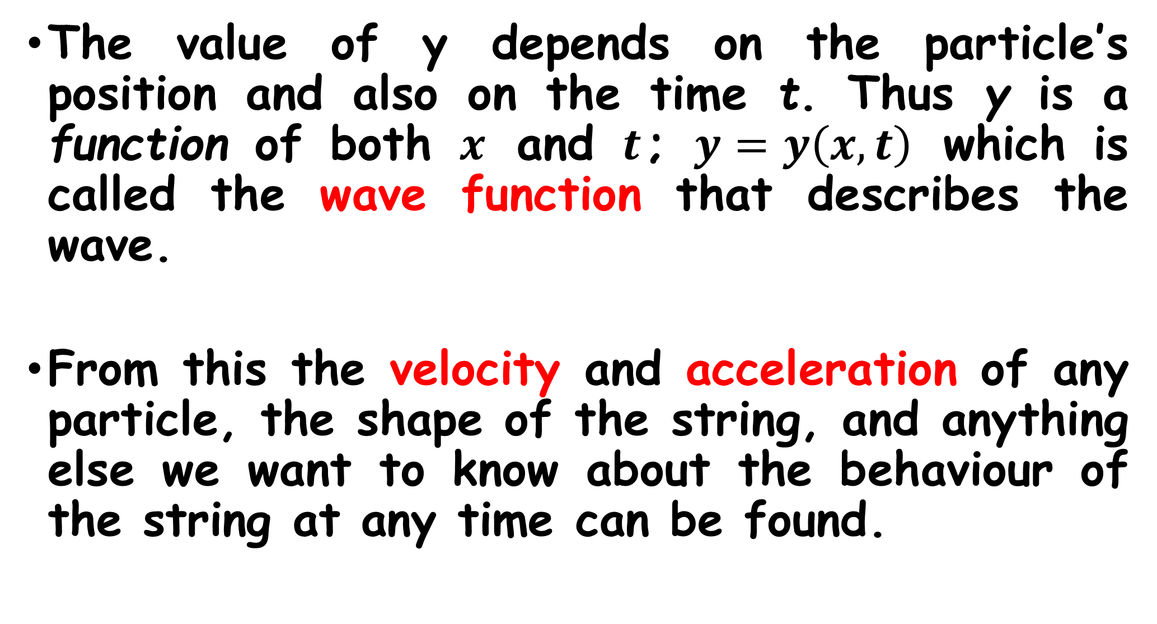
The value of y depends on the particle’s position and also on the time t. Thus y is a function of both $x$ and $t$; $y=y\left(x,t\right)$ which is called the wave function that describes the wave.
From this the velocity and acceleration of any particle, the shape of the string, and anything else we want to know about the behaviour of the string at any time can be found.

Slide 26
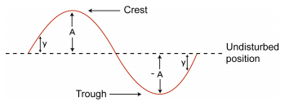

Suppose the displacement of a particle at the left end of a string $\left(x=0\right)$, where the wave originates, is given by
$y\left(x=0,t\right)=A cosωt=A\cos{2πft}$ (2)

Slide 27
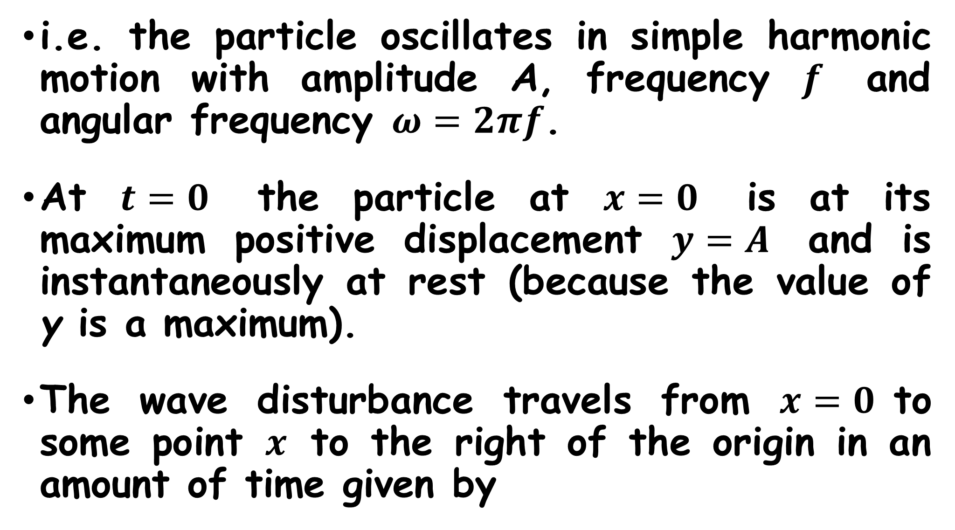
i.e. the particle oscillates in simple harmonic motion with amplitude A, frequency $f$ and angular frequency $ω=2πf$.
At $t=0$ the particle at $x=0$ is at its maximum positive displacement $y=A$ and is instantaneously at rest (because the value of y is a maximum).
The wave disturbance travels from $x=0$to some point $x$ to the right of the origin in an amount of time given by

Slide 28
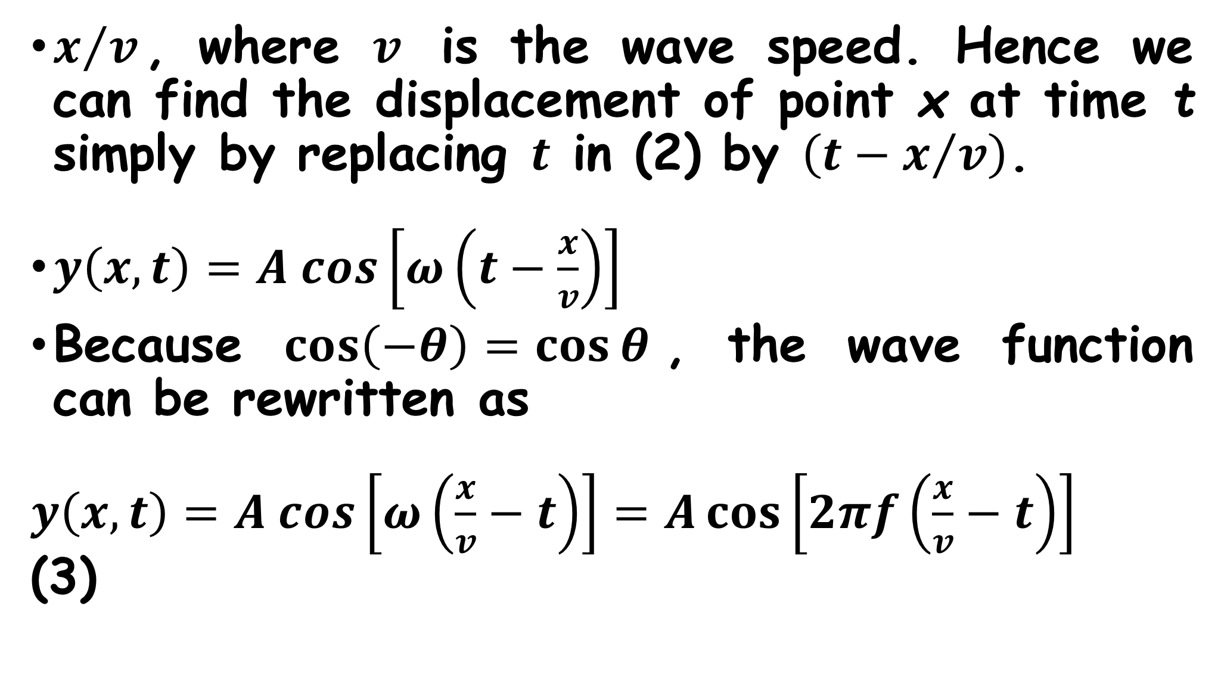
$x/v$, where $v$ is the wave speed. Hence we can find the displacement of point x at time t simply by replacing $t$ in (2) by $\left(t−x/v\right)$.
$y\left(x,t\right)=A cos\left[ω\left(t−\frac{x}{v}\right)\right]$
Because $\cos\left(−θ\right)=\cos{θ}$, the wave function can be rewritten as
$y\left(x,t\right)=A cos\left[ω\left(\frac{x}{v}−t\right)\right]=A\cos\left[2πf\left(\frac{x}{v}−t\right)\right]$ (3)

Slide 29
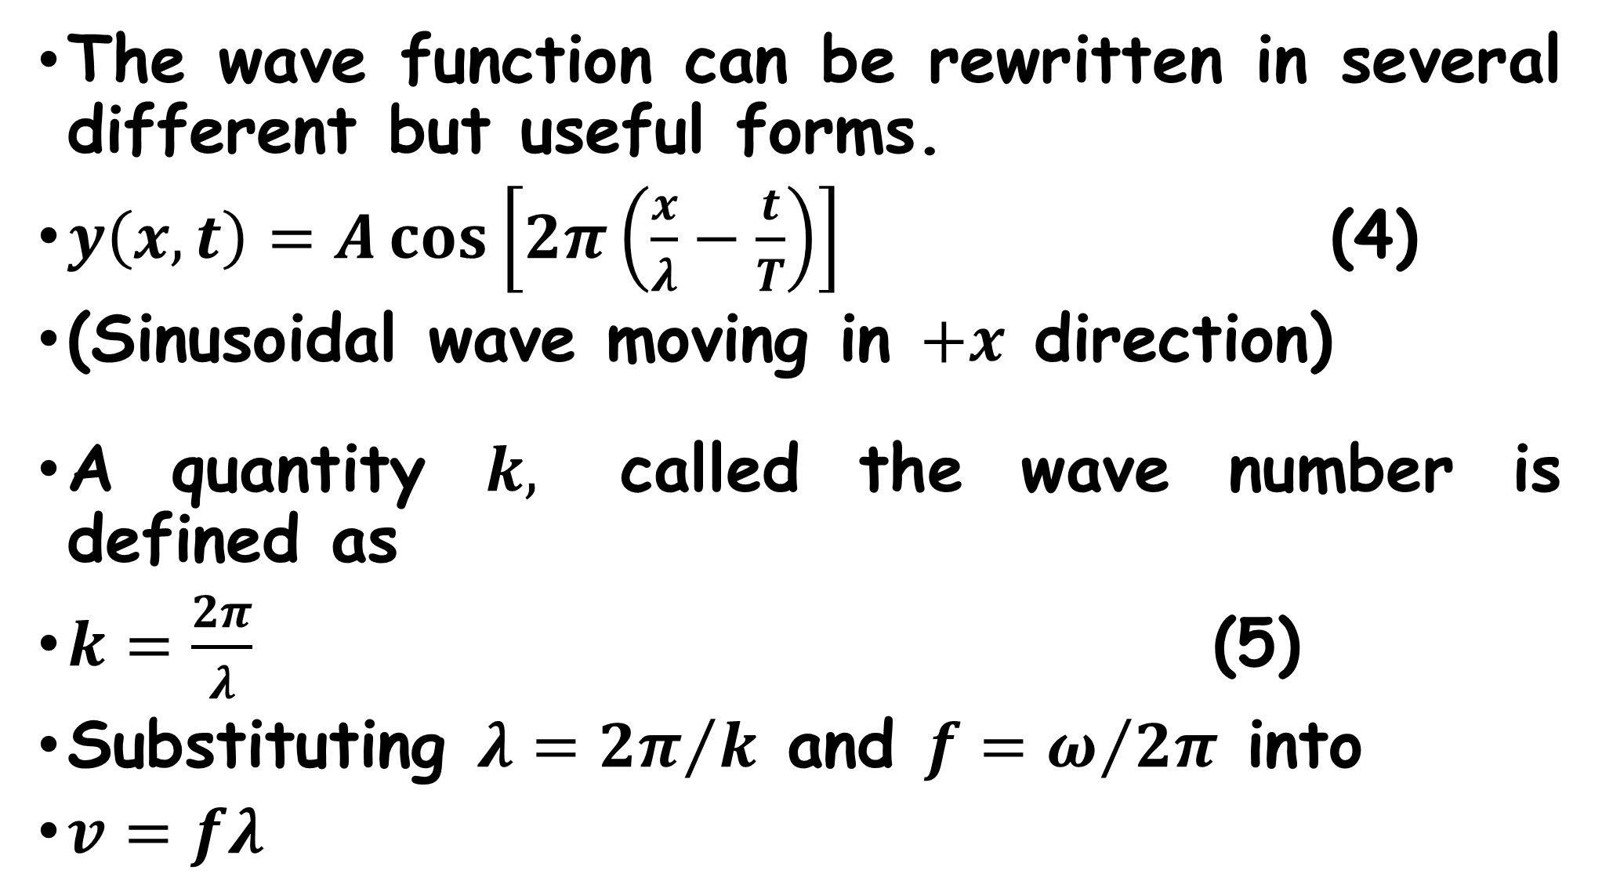
The wave function can be rewritten in several different but useful forms.
$y\left(x,t\right)=A\cos\left[2π\left(\frac{x}{λ}−\frac{t}{T}\right)\right]$ (4)
(Sinusoidal wave moving in $+x$ direction)
A quantity $k,$ called the wave number is defined as
$k=\frac{2π}{λ}$ (5)
Substituting $λ={2π}/k$ and $f=ω/{2π}$ into
$v=fλ$

Slide 30
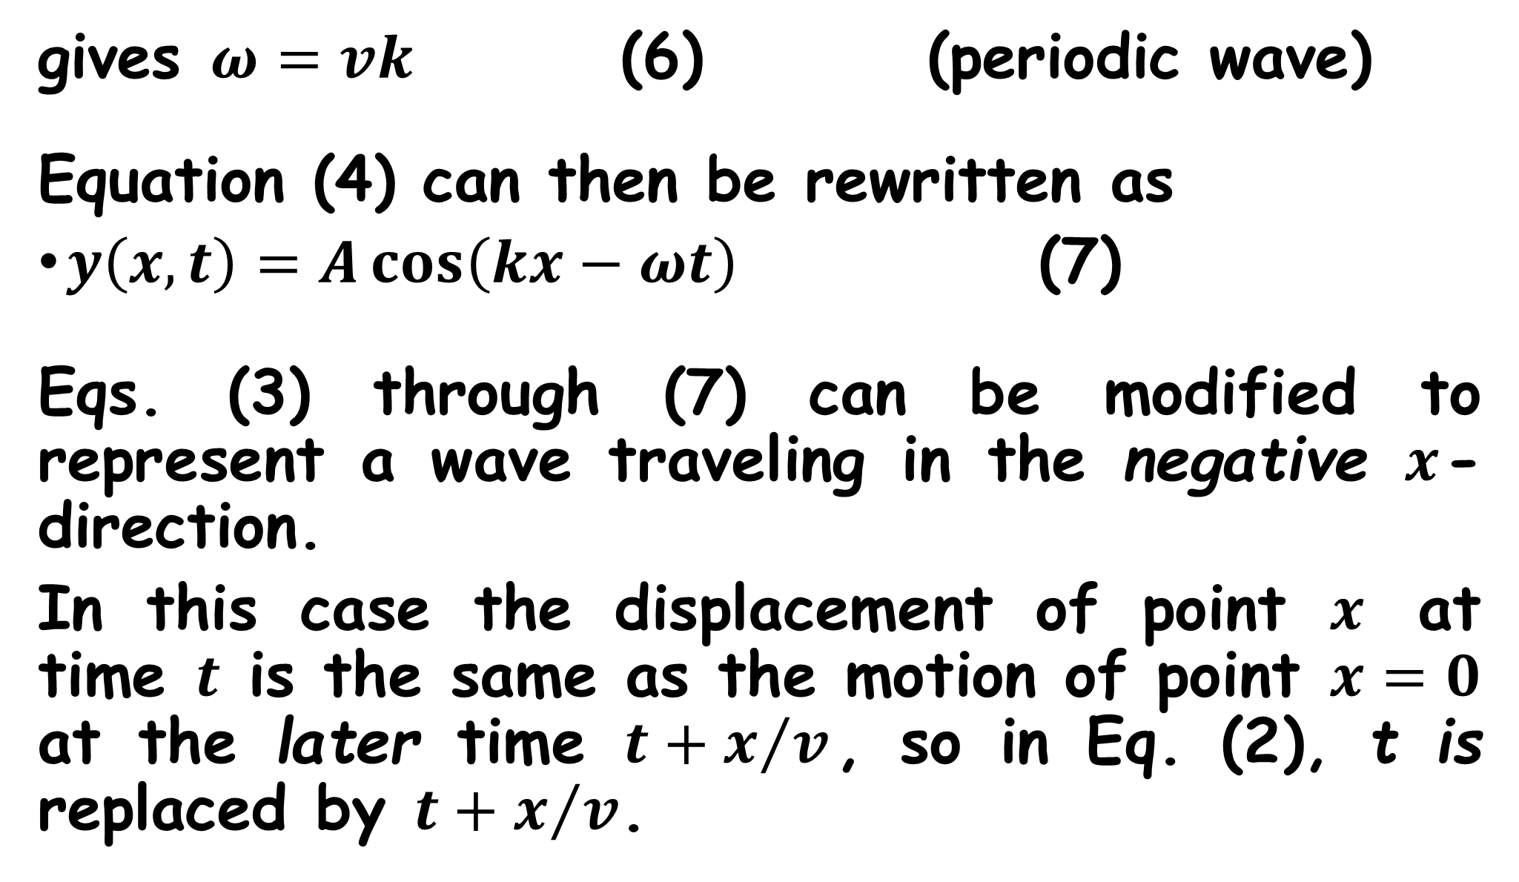
gives $ω=vk$ (6) (periodic wave)
Equation (4) can then be rewritten as
$y\left(x,t\right)=A\cos\left(kx−ωt\right)$ (7)
Eqs. (3) through (7) can be modified to represent a wave traveling in the negative $x$-direction.
In this case the displacement of point $x$ at time $t$ is the same as the motion of point $x=0$ at the later time $t+x/v$, so in Eq. (2), t is replaced by $t+x/v$.

Slide 31
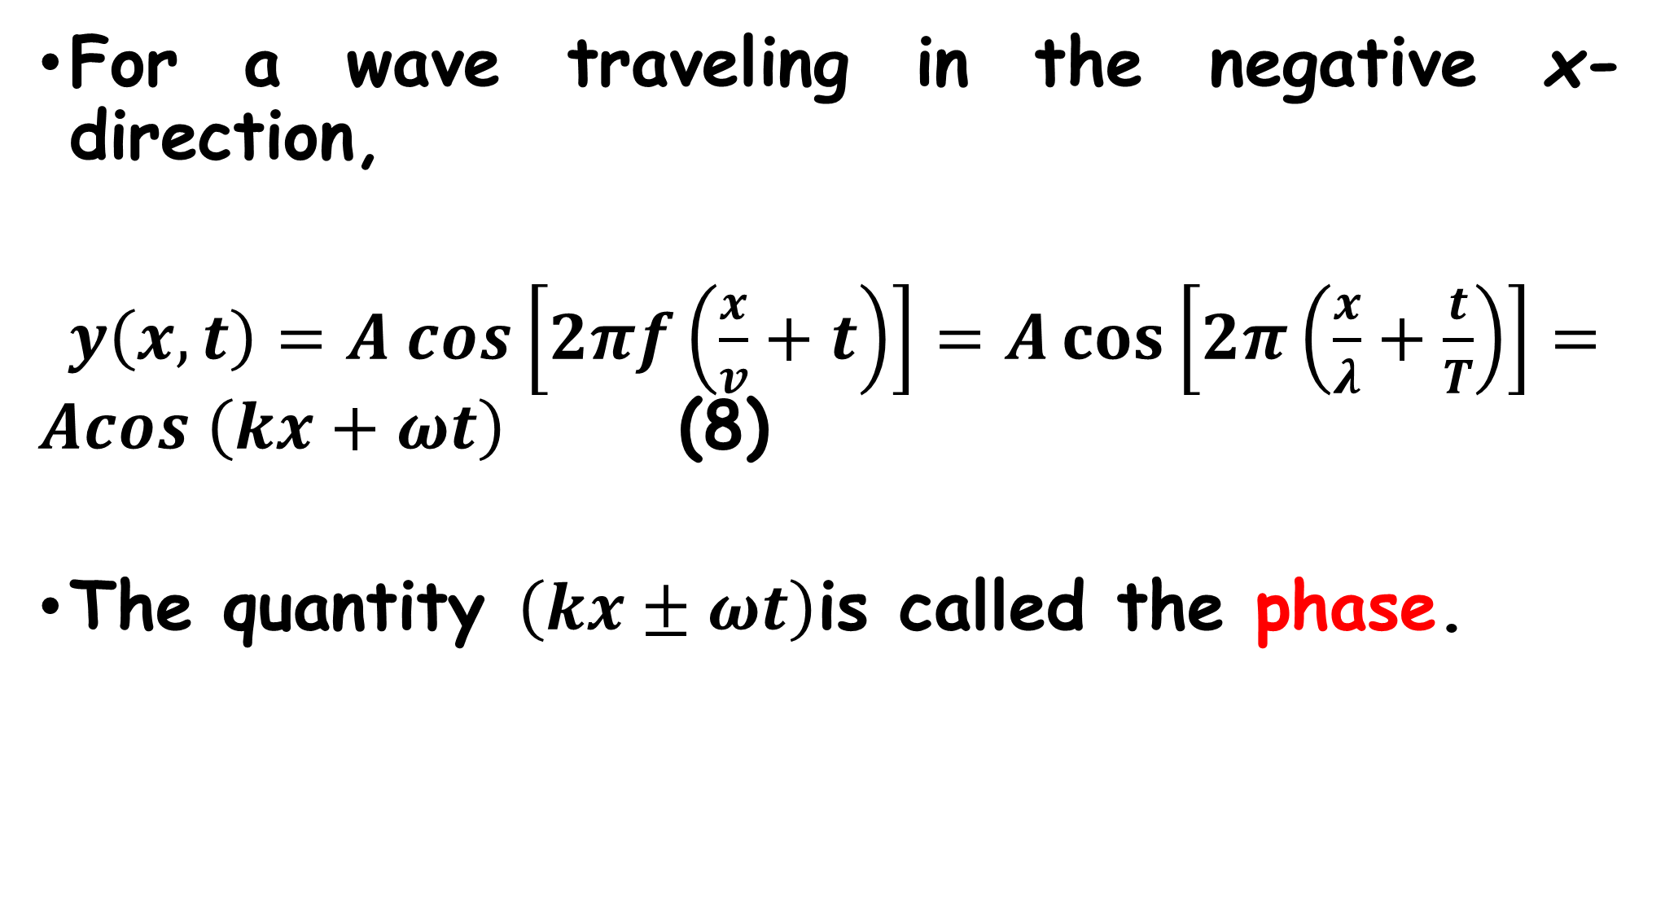
For a wave traveling in the negative x-direction,
$y\left(x,t\right)=A cos\left[2πf\left(\frac{x}{v}+t\right)\right]=A\cos\left[2π\left(\frac{x}{λ}+\frac{t}{T}\right)\right]=Acos \left(kx+ωt\right)$ (8)
The quantity $\left(kx±ωt\right)$is called the phase.

Slide 32
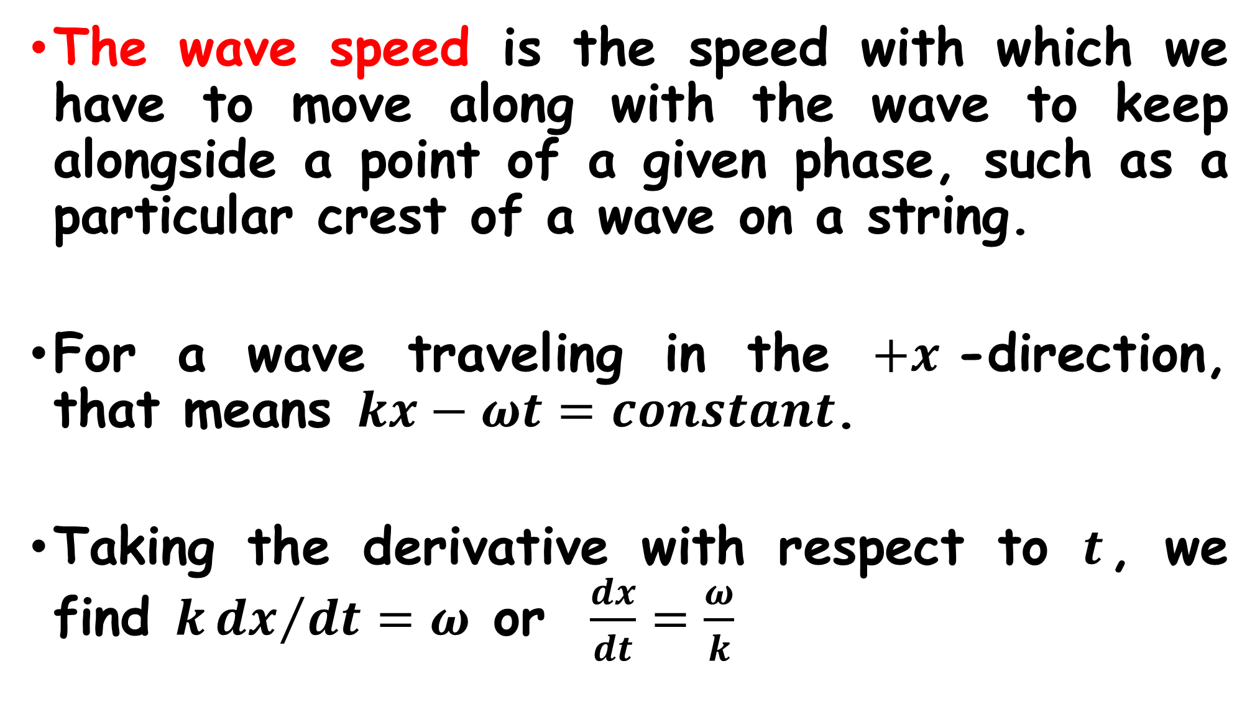
The wave speed is the speed with which we have to move along with the wave to keep alongside a point of a given phase, such as a particular crest of a wave on a string.
For a wave traveling in the $+x$-direction, that means $kx−ωt=constant$.
Taking the derivative with respect to $t$, we find $k{dx}/{dt}=ω$ or $\frac{dx}{dt}=\frac{ω}{k}$

Slide 33
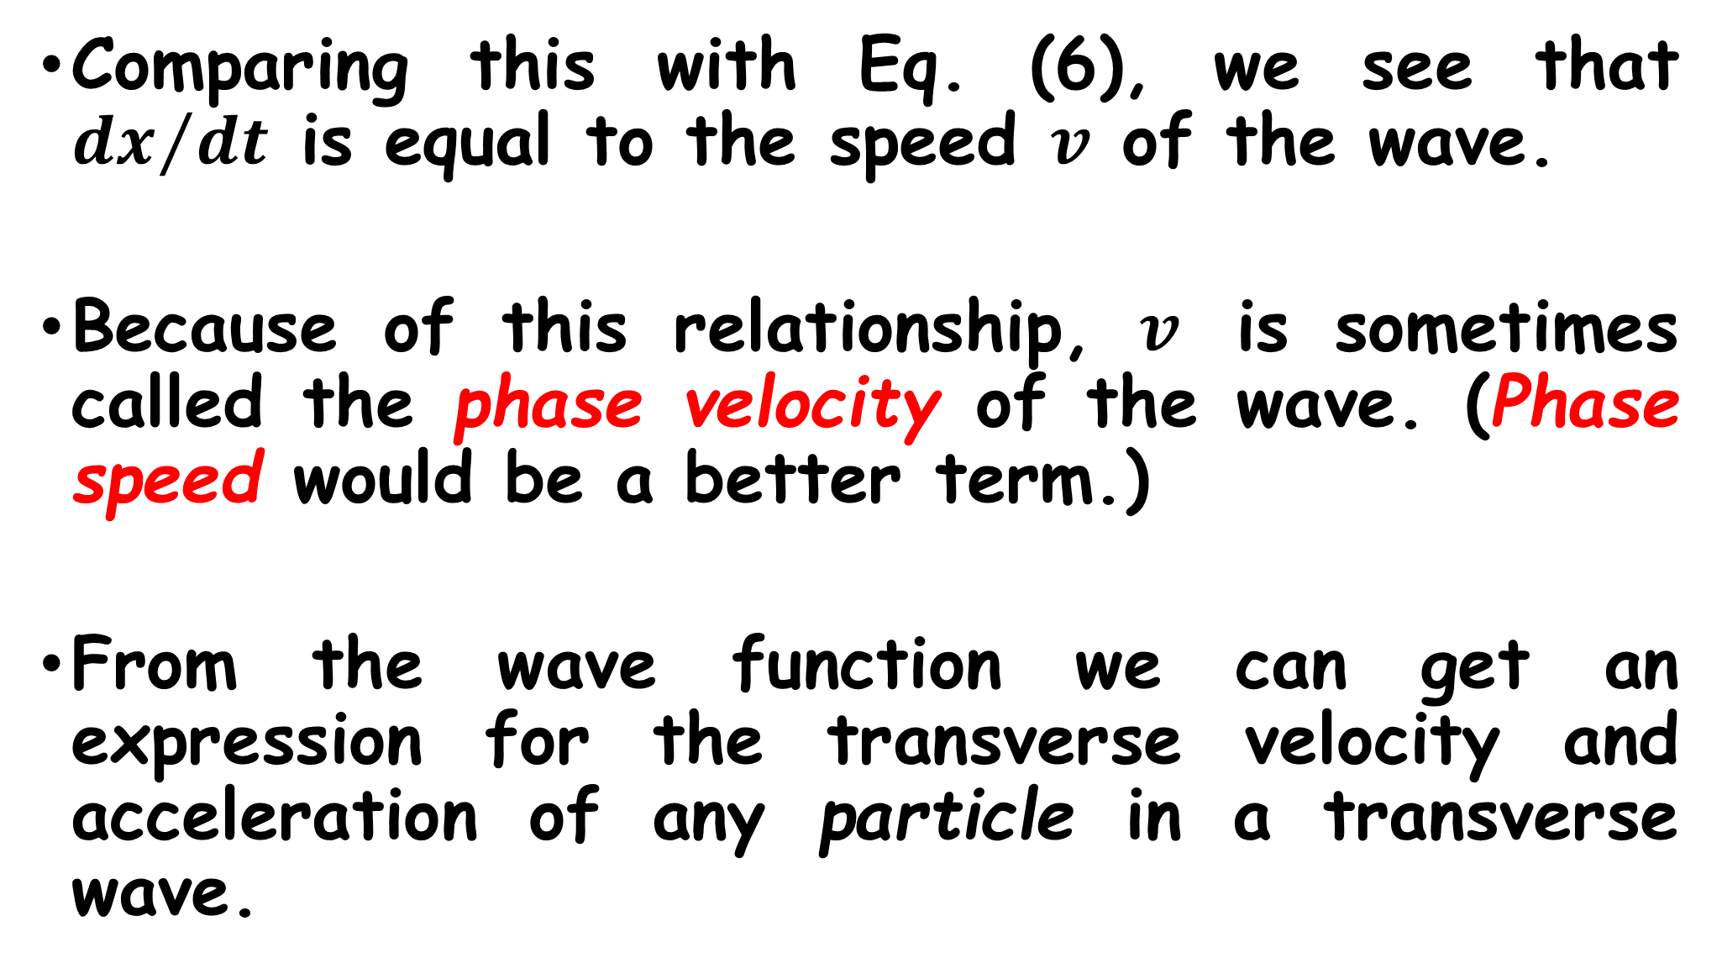
Comparing this with Eq. (6), we see that ${dx}/{dt}$ is equal to the speed $v$ of the wave.
Because of this relationship, $v$ is sometimes called the phase velocity of the wave. (Phase speed would be a better term.)
From the wave function we can get an expression for the transverse velocity and acceleration of any particle in a transverse wave.

Slide 34
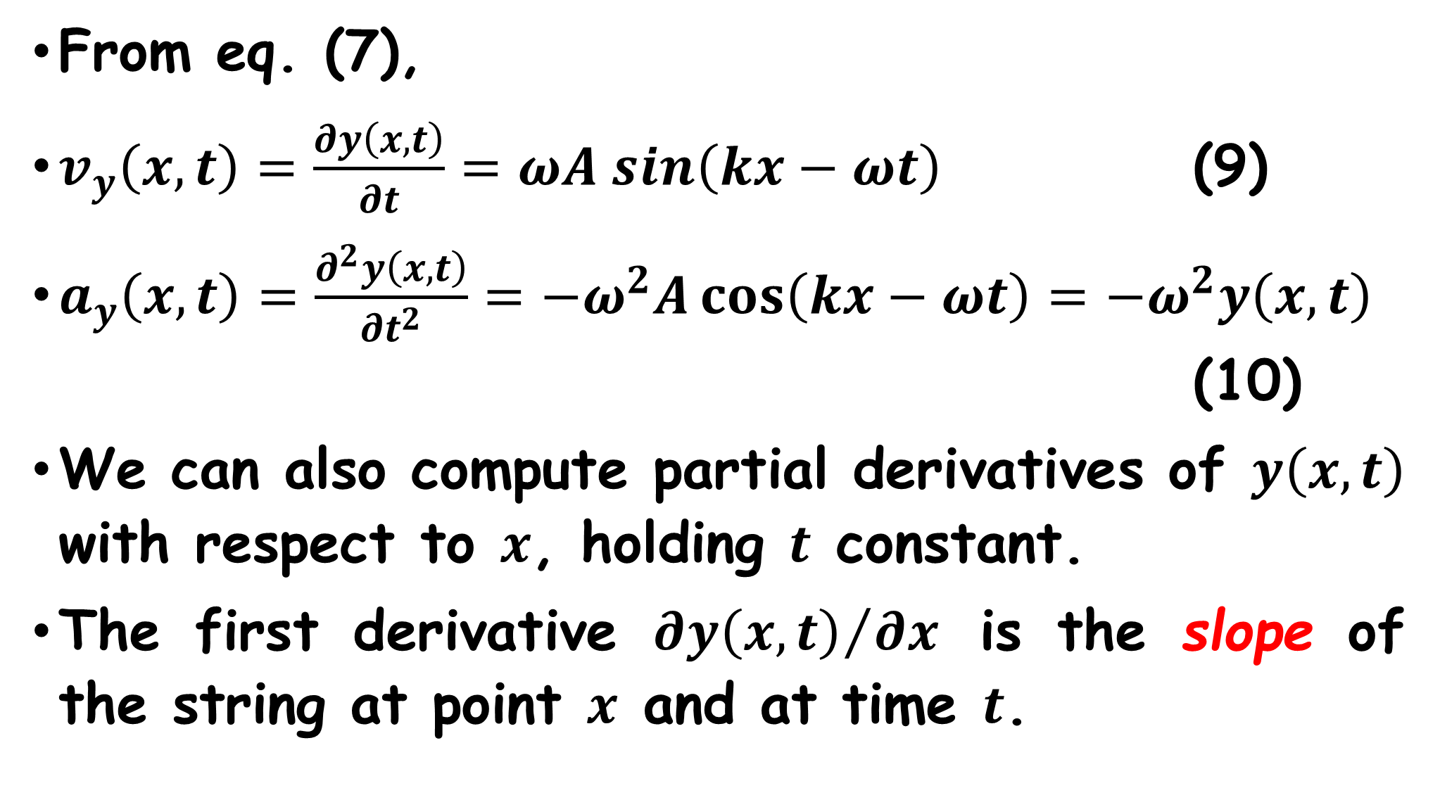
From eq. (7),
$v_{y}\left(x,t\right)=\frac{∂y\left(x,t\right)}{∂t}=ωA sin\left(kx−ωt\right)$ (9)
$a_{y}\left(x,t\right)=\frac{∂^{2}y\left(x,t\right)}{∂t^{2}}=−ω^{2}A\cos\left(kx−ωt\right)=−ω^{2}y\left(x,t\right)$ (10)
We can also compute partial derivatives of $y\left(x,t\right)$ with respect to $x$, holding $t$ constant.
The first derivative ${∂y\left(x,t\right)}/{∂x}$ is the slope of the string at point $x$ and at time $t$.

Slide 35
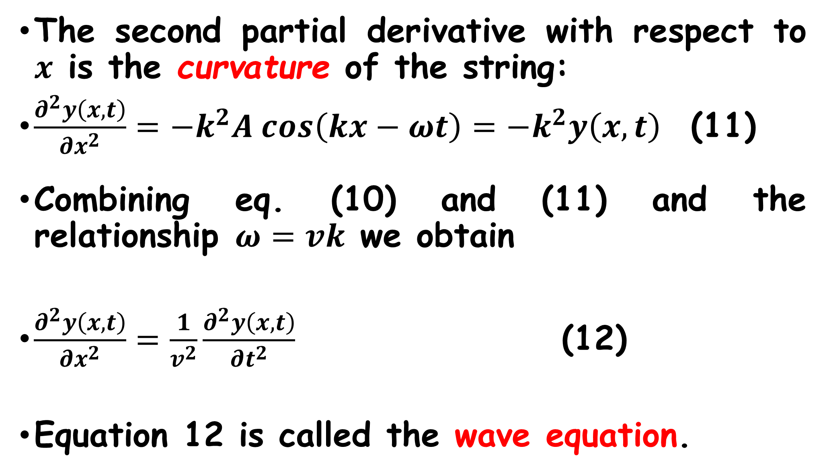
The second partial derivative with respect to $x$ is the curvature of the string:
$\frac{∂^{2}y\left(x,t\right)}{∂x^{2}}=−k^{2}A cos\left(kx−ωt\right)=−k^{2}y\left(x,t\right)$ (11)
Combining eq. (10) and (11) and the relationship $ω=vk$ we obtain
$\frac{∂^{2}y\left(x,t\right)}{∂x^{2}}=\frac{1}{v^{2}}\frac{∂^{2}y\left(x,t\right)}{∂t^{2}}$ (12)
Equation 12 is called the wave equation.

Slide 36
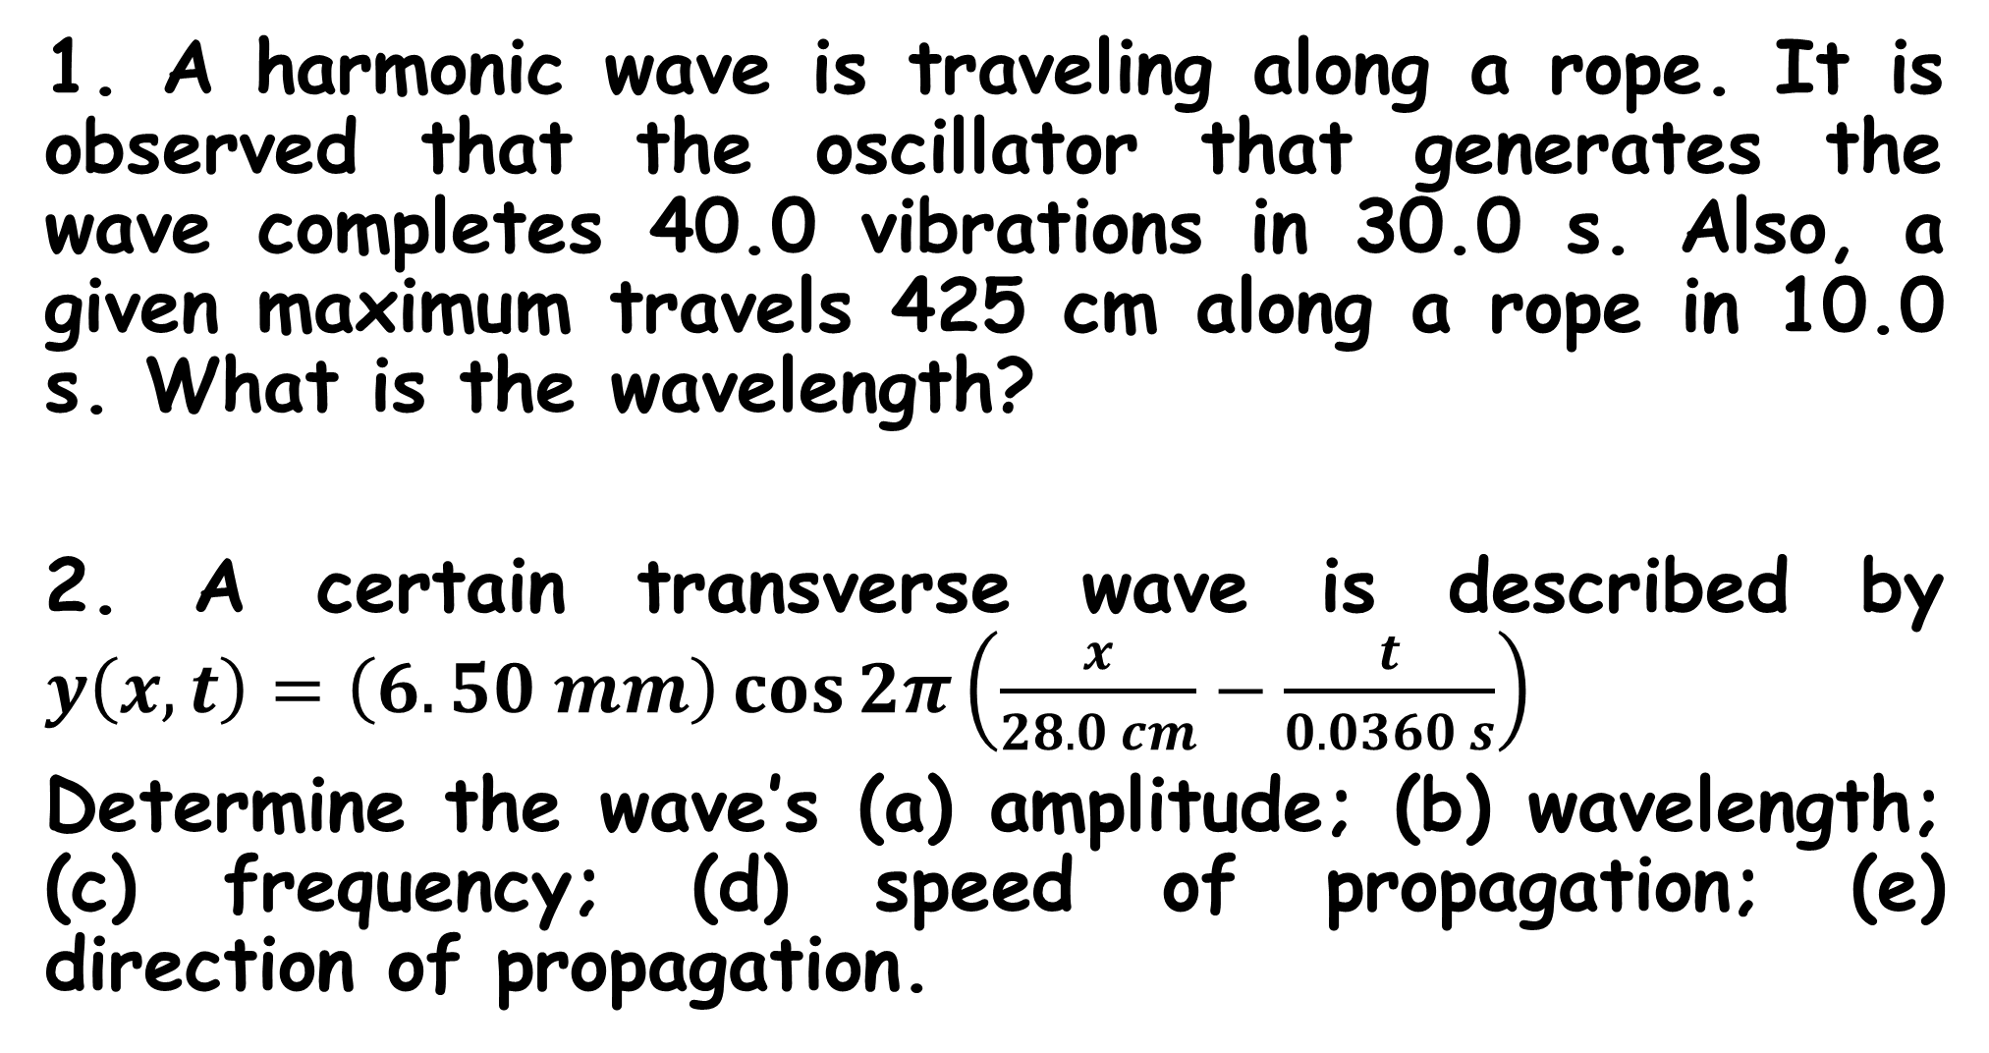
QUESTIONS
1. A harmonic wave is traveling along a rope. It is observed that the oscillator that generates the wave completes 40.0 vibrations in 30.0 s. Also, a given maximum travels 425 cm along a rope in 10.0 s. What is the wavelength?
2. A certain transverse wave is described by $y\left(x,t\right)=\left(6.50 mm\right)\cos{2π\left(\frac{x}{28.0 cm}−\frac{t}{0.0360 s}\right)}$
Determine the wave’s (a) amplitude; (b) wavelength; (c) frequency; (d) speed of propagation; (e) direction of propagation.

Slide 37
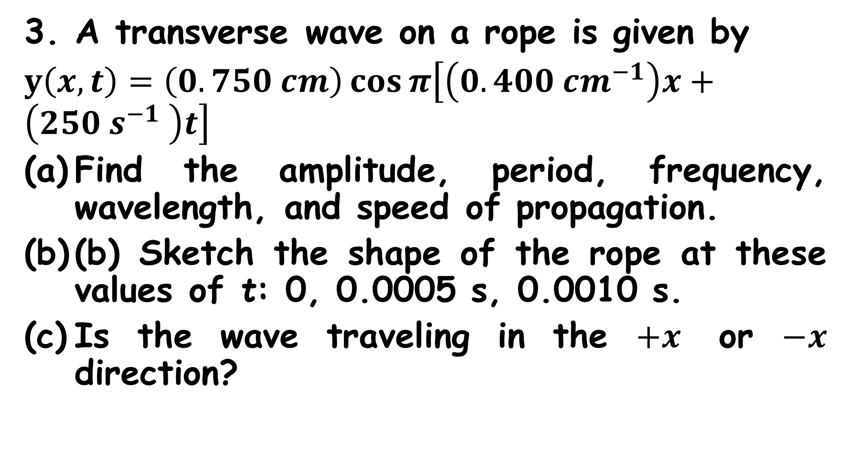
3. A transverse wave on a rope is given by
$y\left(x,t\right)=\left(0.750 cm\right)\cos{π\left[\left(0.400 {cm}^{−1}\right)x+\left(250 s^{−1} \right)t\right]}$
Find the amplitude, period, frequency, wavelength, and speed of propagation.
(b) Sketch the shape of the rope at these values of t: 0, 0.0005 s, 0.0010 s.
Is the wave traveling in the $+x$ or $−x$ direction?

Slide 38
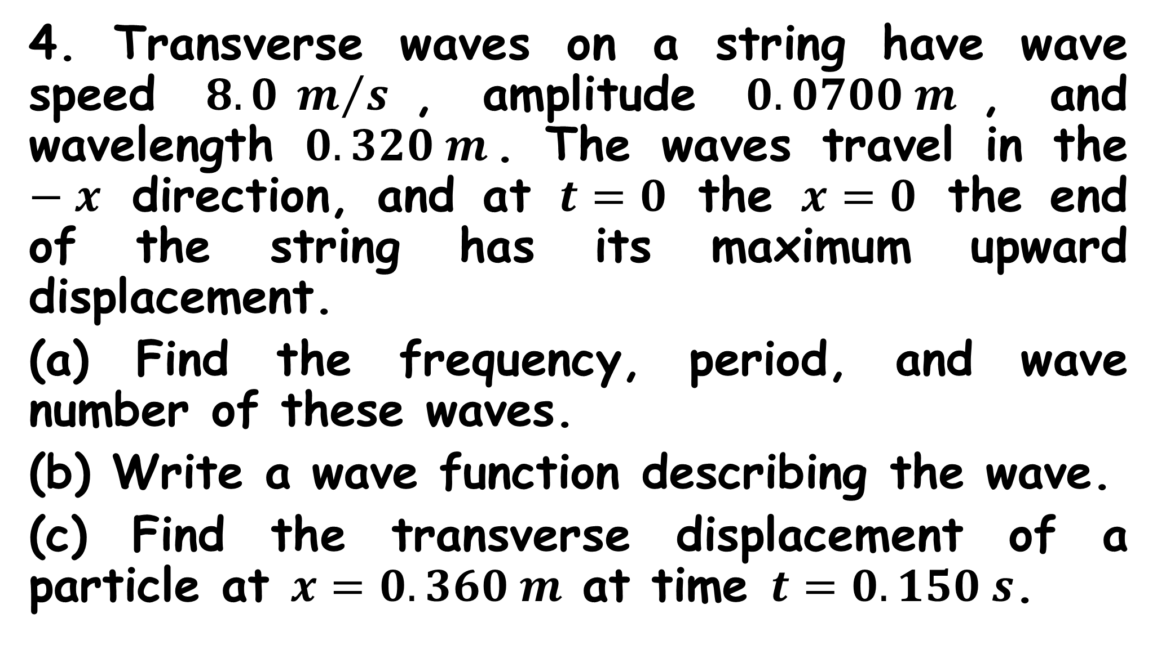
4. Transverse waves on a string have wave speed $8.0 m/s$, amplitude $0.0700 m$, and wavelength $0.320 m$. The waves travel in the $−x$ direction, and at $t=0$ the $x=0$ the end of the string has its maximum upward displacement.
(a) Find the frequency, period, and wave number of these waves.
(b) Write a wave function describing the wave.
(c) Find the transverse displacement of a particle at $x=0.360 m$ at time $t=0.150 s$.

Slide 39
Wave Interference
If two waves were traveling together in the same medium, the medium would react to both waves together, resulting in a single wave. This phenomenon is called superposition of waves.
When two waves interact in this manner, they are said to be interfering with each other.

Slide 40
Consider what happens when you combine two waves that have the same wavelength and the same amplitude, oriented in such a way that the crests and troughs of the two waves are aligned with each other. Such waves are said to be in phase.
The resultant wave that occurs when the two waves overlap and interfere with each other is a wave with twice the amplitude of the original waves.

Slide 41
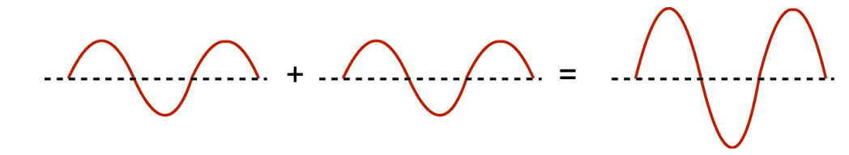
This is called constructive interference.
The overall displacement of any point in the medium is the algebraic sum of the displacements provided by each of the two waves that are interfering with each other.

Slide 42
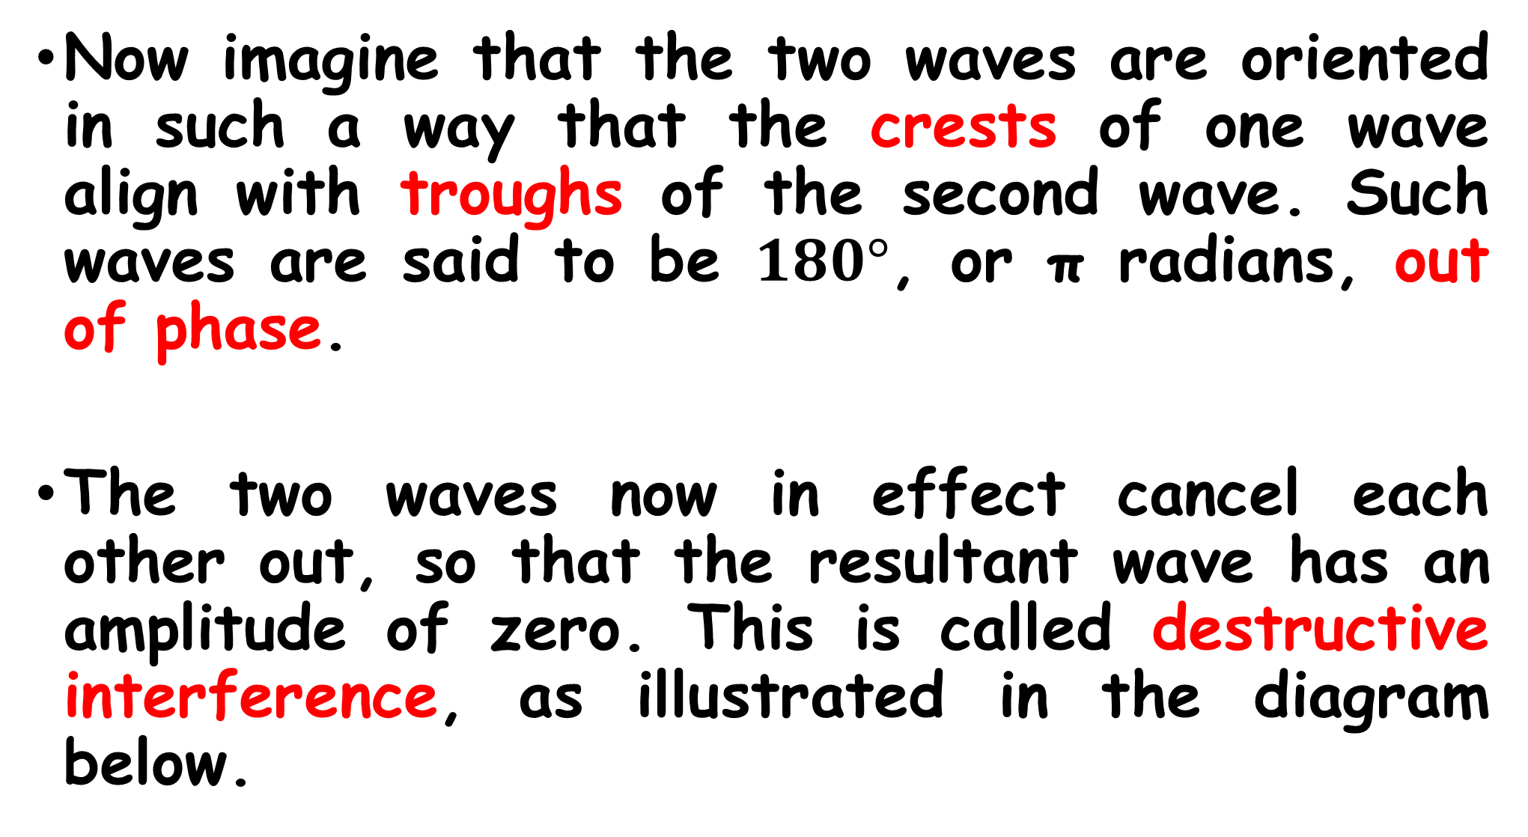
Now imagine that the two waves are oriented in such a way that the crests of one wave align with troughs of the second wave. Such waves are said to be $180°$, or π radians, out of phase.
The two waves now in effect cancel each other out, so that the resultant wave has an amplitude of zero. This is called destructive interference, as illustrated in the diagram below.

Slide 43
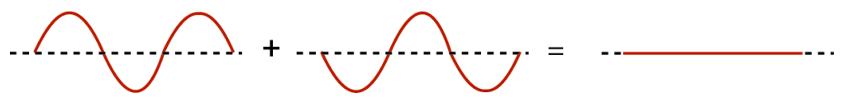

This occurs when they both have the same amplitude and wavelength.
What if the two waves that are interfering with each other are not perfectly in phase or $180°$ out of phase, but rather something in between?

Slide 44
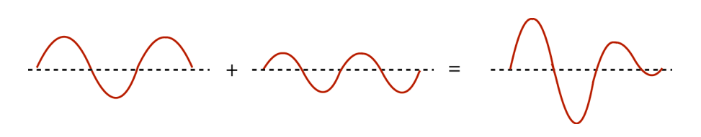
In situations such as these the waves still interfere with each other, but the result is not perfectly constructive or perfectly destructive.
The overall displacement of the medium is still the algebraic sum of the individual displacements provided by the original wave. An example of such a situation is seen in the diagram below.

Slide 45
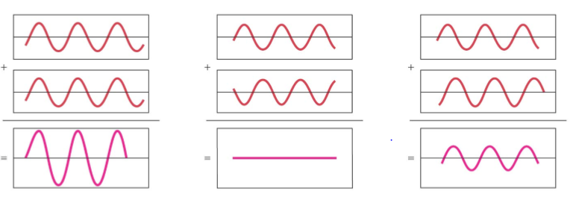

Slide 46
A standing wave is the result of the superposition of the original or incident wave traveling in one direction and its reflection traveling in the opposite direction.
It produces a wave pattern that seemed to be stationary at certain places on the string which appeared to never move, while others were in constant motion.

Slide 47
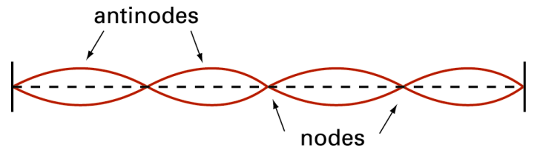
The locations along the wave where no displacement of the medium appears to take place are called nodes, while those places that oscillate between maximum positive and negative displacement are called antinodes.
These same situations exist in a standing sound wave as well.

Slide 48
IN-PHASE VIBRATIONS exist at two points on a wave if those points undergo vibrations that are in the same direction i.e. in step.
For example in the Figure in slide 47, particles of the string at the same points vibrate in-phase since they move up and down together.
Vibrations are in phase if the points are a whole number of wavelengths apart.
Vibrations are out-of-phase if the points are not whole number apart.

Slide 49
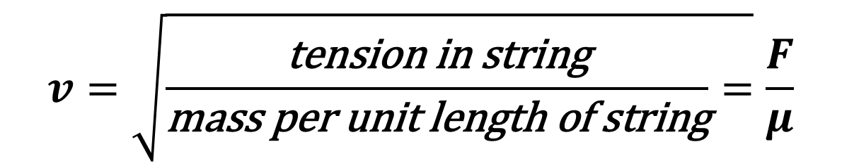
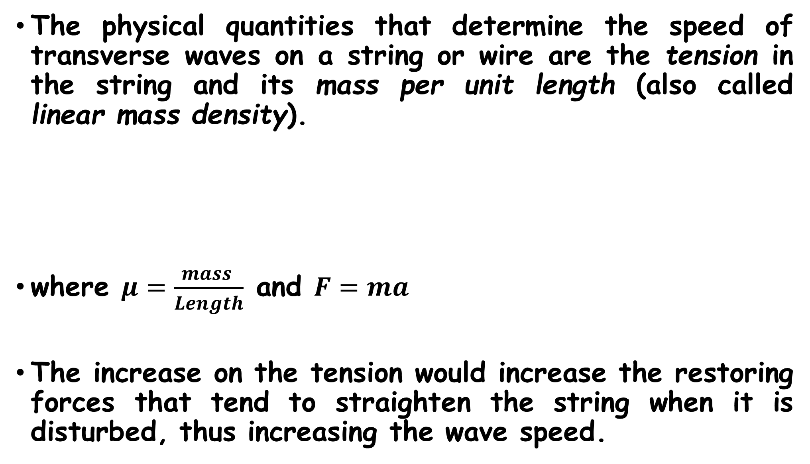
The physical quantities that determine the speed of transverse waves on a string or wire are the tension in the string and its mass per unit length (also called linear mass density).
where $μ=\frac{mass }{Length}$ and $F=ma$
The increase on the tension would increase the restoring forces that tend to straighten the string when it is disturbed, thus increasing the wave speed.
$$v=\sqrt{\frac{\text{tension} \text{in} \text{string}}{\text{mass} \text{per} \text{unit} \text{length} \text{of} \text{string}}=}\frac{F}{μ}$$

Slide 50
Also increasing the mass would make the motion more sluggish and decrease the speed. The exact relationship among wave speed, tension, and mass per unit length by two different methods.

Slide 51
ENERGY IN WAVE MOTION
Every wave motion has energy associated with it. E.g. the energy from sunlight and the destructive effects of ocean surf and earthquakes.
To produce any of the wave motions a force must be applied to a portion of the wave medium; the point where the force is applied moves, hence work is done on the system.
As the wave propagates, each portion of the medium exerts a force and does work on the adjoining portion. In this way a wave can transport energy from one region of space to another.

Slide 52
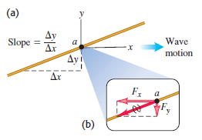
Considering transverse waves on a string to understand how energy is transferred from one portion of a string to another.
In the Figure above, a wave is traveling from left to right (the positive x-direction) on the string, and considering a particular point a on the string.

Slide 53
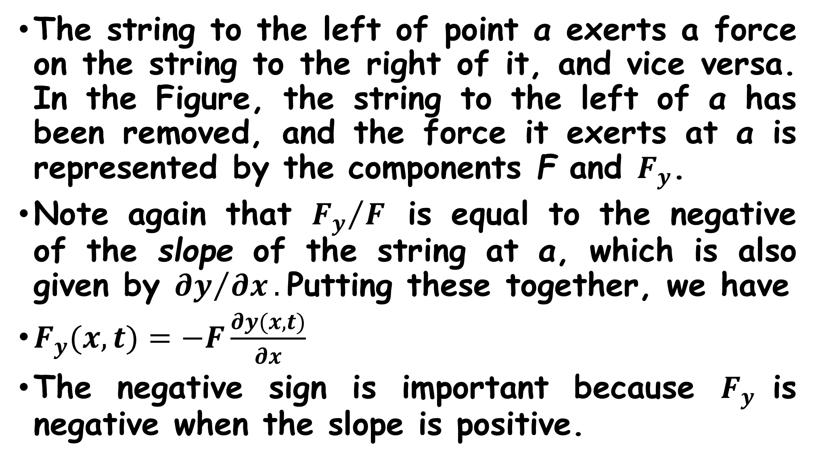
The string to the left of point a exerts a force on the string to the right of it, and vice versa. In the Figure, the string to the left of a has been removed, and the force it exerts at a is represented by the components F and $F_{y}$.
Note again that ${F_{y}}/F$ is equal to the negative of the slope of the string at a, which is also given by ${∂y}/{∂x}.$Putting these together, we have
$F_{y}(x,t)=−F\frac{∂y(x,t)}{∂x}$
The negative sign is important because $F_{y}$is negative when the slope is positive.

Slide 54

The corresponding power P (rate of doing work) at the any point is the transverse force times the transverse velocity of that point.
This power is the instantaneous rate at which energy is transferred along the string. Its value depends on the position x on the string and on the time t.
Energy is being transferred only at points where the string has a nonzero slope ( is nonzero), so that there is a transverse component of the tension force.
$$P\left(x,t\right)=F_{y}\left(x,t\right)v_{y}\left(x,t\right)=−F\frac{∂y(x,t)}{∂x}\frac{∂y(x,t)}{∂t}$$
${∂y}/{∂x}$

Slide 55

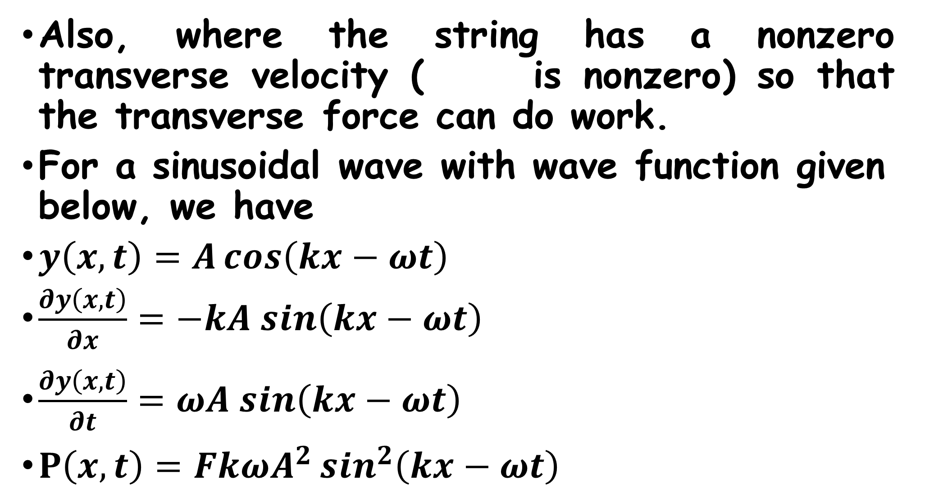
Also, where the string has a nonzero transverse velocity ( is nonzero) so that the transverse force can do work.
For a sinusoidal wave with wave function given below, we have
$y\left(x,t\right)=A\cos\left(kx−ωt\right)$
$\frac{∂y\left(x,t\right)}{∂x}=−kA sin\left(kx−ωt\right)$
$\frac{∂y\left(x,t\right)}{∂t}=ωA sin\left(kx−ωt\right)$
$P\left(x,t\right)=FkωA^{2}\sin^{2}\left(kx−ωt\right)$
$${∂y}/{∂t}$$

Slide 56
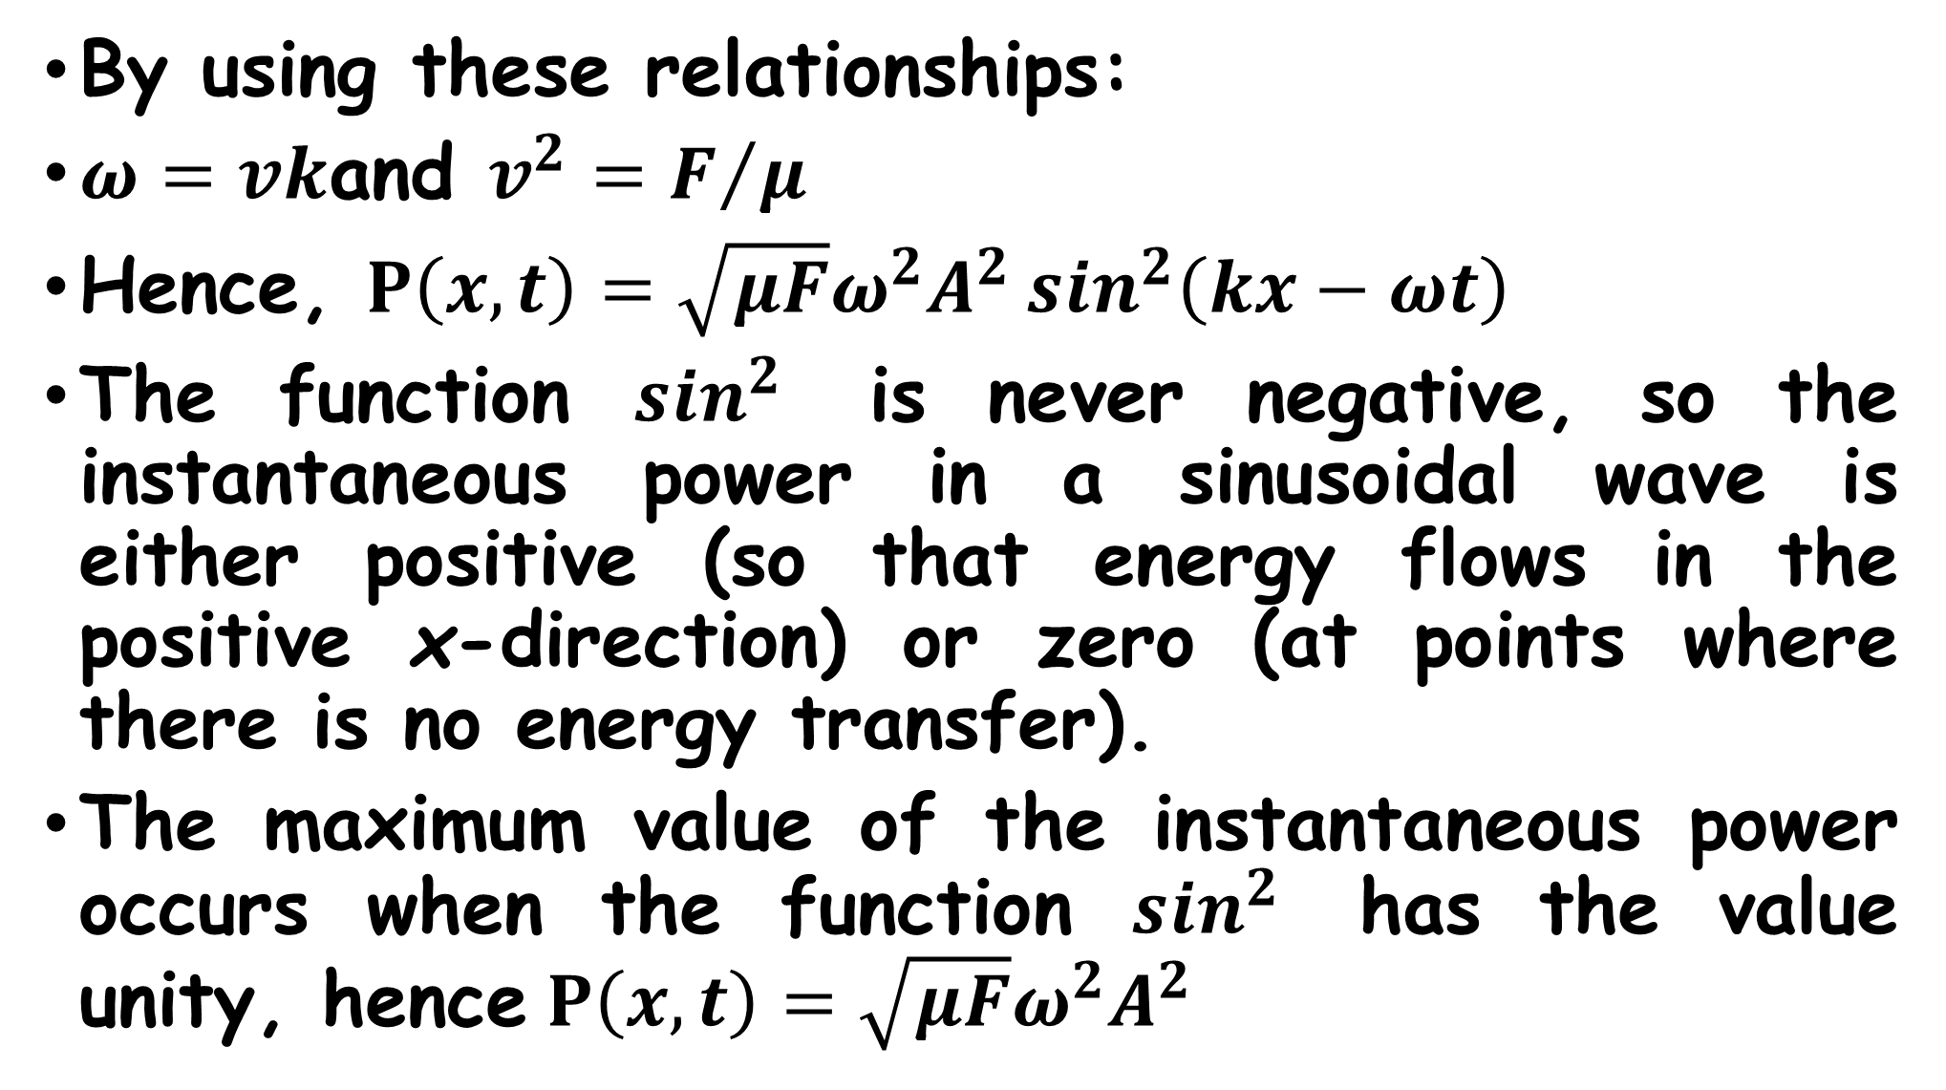
By using these relationships:
$ω=vk$ and $v^{2}=F/μ$
Hence, $P\left(x,t\right)=\sqrt{μF}ω^{2}A^{2}\sin^{2}\left(kx−ωt\right)$
The function $\sin^{2}$ is never negative, so the instantaneous power in a sinusoidal wave is either positive (so that energy flows in the positive x-direction) or zero (at points where there is no energy transfer).
The maximum value of the instantaneous power occurs when the function $\sin^{2}$ has the value unity, hence $P\left(x,t\right)=\sqrt{μF}ω^{2}A^{2}$

Slide 57
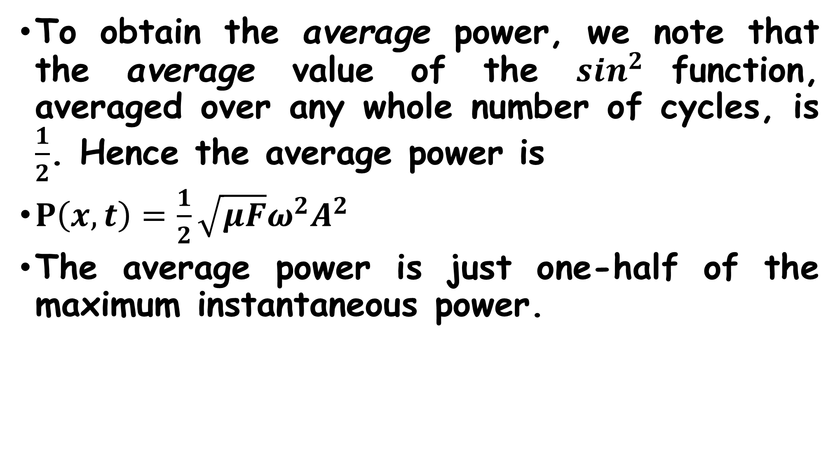
To obtain the average power, we note that the average value of the $\sin^{2}$function, averaged over any whole number of cycles, is $\frac{1}{2}$. Hence the average power is
$P\left(x,t\right)=\frac{1}{2}\sqrt{μF}ω^{2}A^{2}$
The average power is just one-half of the maximum instantaneous power.

Slide 58
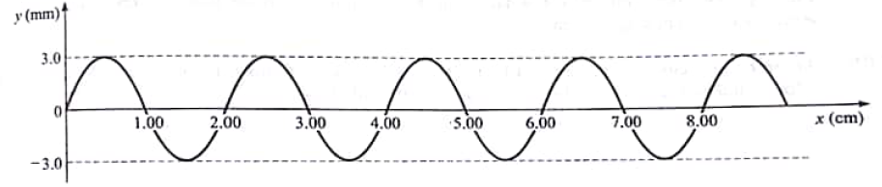
Questions
1. The wave shown in the Figure below is being sent out by a 60 cycles/s vibrator. Find the following for the wave:
(a) amplitude
(b) frequency
(c) wavelength
(d) speed
(e) period

Slide 59
2 One end of a 2.00-kg rope is tied to a support at the top of a mine shaft 80.0 m deep. The rope is stretched taut by a 20.0-kg box of rocks attached at the bottom.
(a) The geologist at the bottom of the shaft signals to a colleague at the top by jerking the rope sideways. What is the speed of a transverse wave on the rope?
(b) If a point on the rope is in transverse SHM with ƒ=2.00 Hz, how many cycles of the wave are there in the rope’s length?

Slide 60
Wave Intensity
Waves on a string carry energy in just one dimension of space i.e. along the direction of the string. But other types of waves, including sound waves in air and seismic waves in the body of the earth, carry energy across all three dimensions of space.
For waves that travel in three dimensions, the intensity (denoted by I) is defined to be the time average rate at which energy is transported by the wave, per unit area,

Slide 61
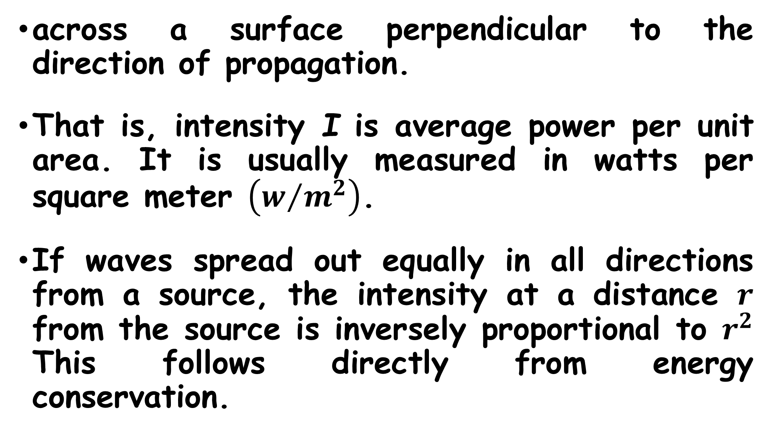
across a surface perpendicular to the direction of propagation.
That is, intensity I is average power per unit area. It is usually measured in watts per square meter $\left(w/{m^{2}}\right)$.
If waves spread out equally in all directions from a source, the intensity at a distance $r$ from the source is inversely proportional to $r^{2}$ This follows directly from energy conservation.

Slide 62
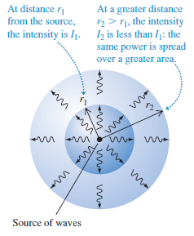

If the power output of the source
is P, then the average intensity $I_{1}$
through a sphere with radius $r_{1}$and
surface area $4π{r_{1}}^{2}$ is
$$I_{1}=\frac{P}{4π{r_{1}}^{2}}$$
The average intensity $I_{2}$ through a
sphere with a different radius $r_{2}$ is
given by similar expression.

Slide 63
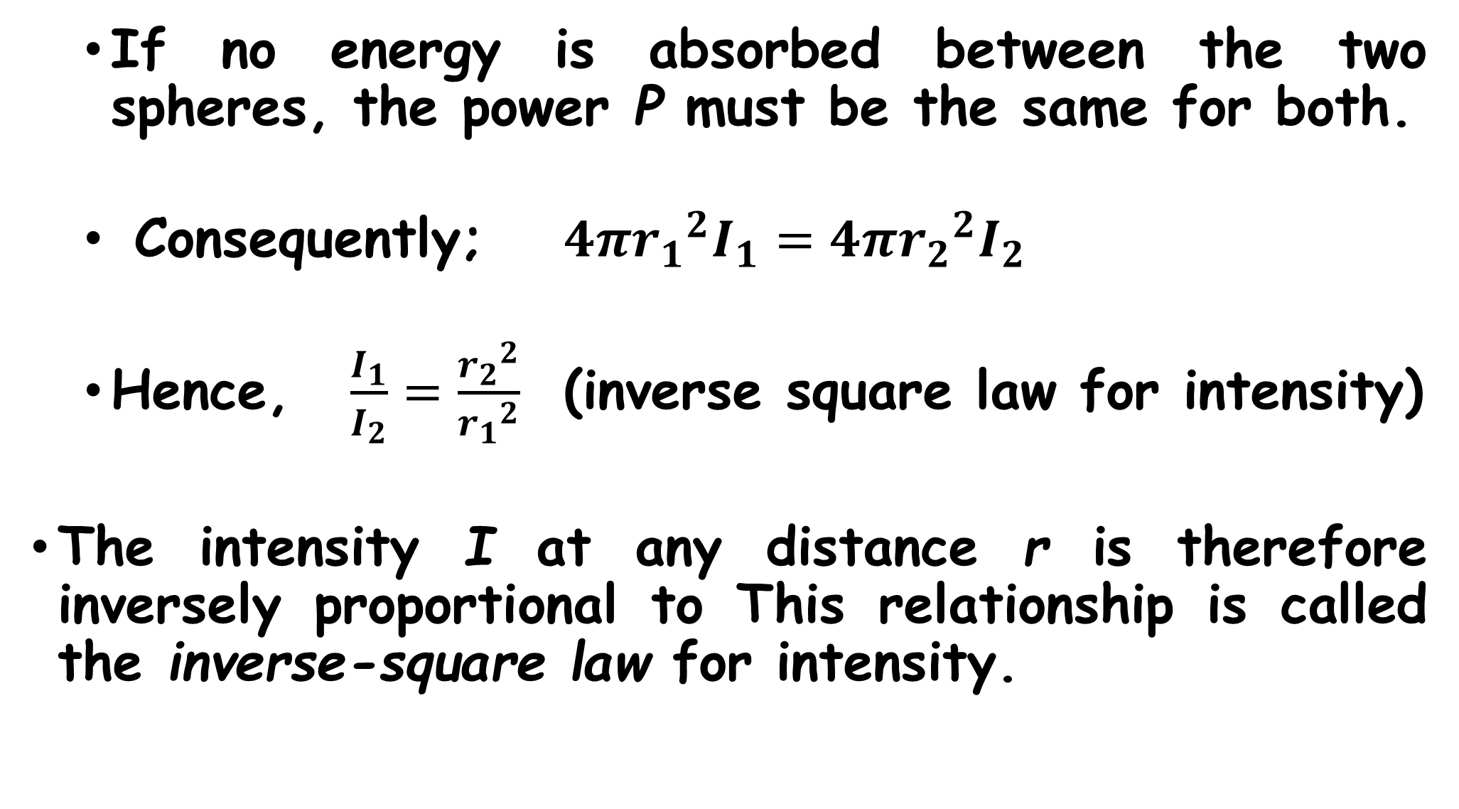
If no energy is absorbed between the two spheres, the power P must be the same for both.
Consequently; $4π{r_{1}}^{2}I_{1}=4π{r_{2}}^{2}I_{2}$
Hence, $\frac{I_{1}}{I_{2}}=\frac{{r_{2}}^{2}}{{r_{1}}^{2}}$ (inverse square law for intensity)
The intensity I at any distance r is therefore inversely proportional to This relationship is called the inverse-square law for intensity.

